Slide 1
Internship At IBM
By: Jiarong LING
Mentor: Hui Sajus
Manager: Nicolas mériau

Slide 2
Overview
Organization
Internship context
Internship projects
Conclusion

Slide 3
Organization
About IBM (Business Machines Cooperation)
Founded in 1911
Revenue of 2019 : 77 billion dollars
Advanced technologies : Watson AI, Cloud Computing, Blockchain etc.
About IBM France
Established since 1914
Revenue of 2019 : over 2 billion euros
Activities : software consulting, France Lab etc.

Slide 4
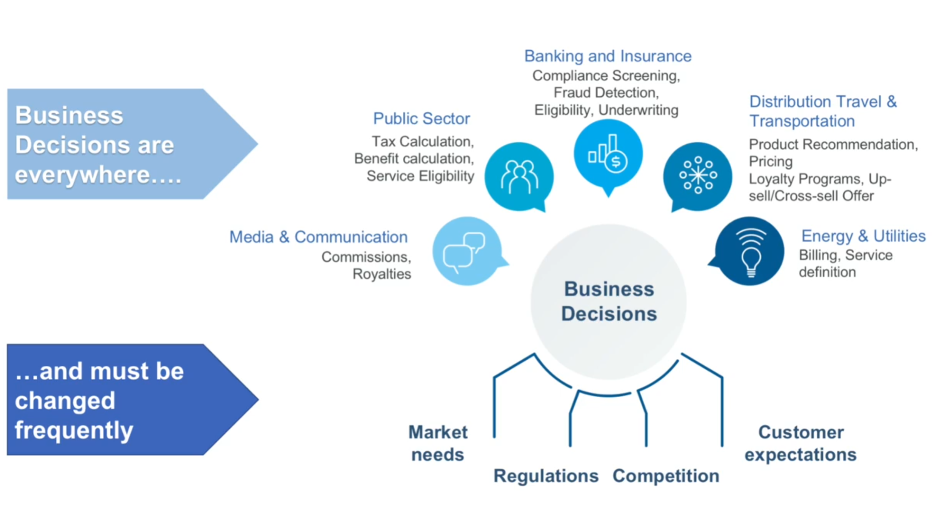
Context
About ODM (Operational Decision Manager )
a set of technologies and methods for clients to automate their day-to-day business decisions

Slide 5
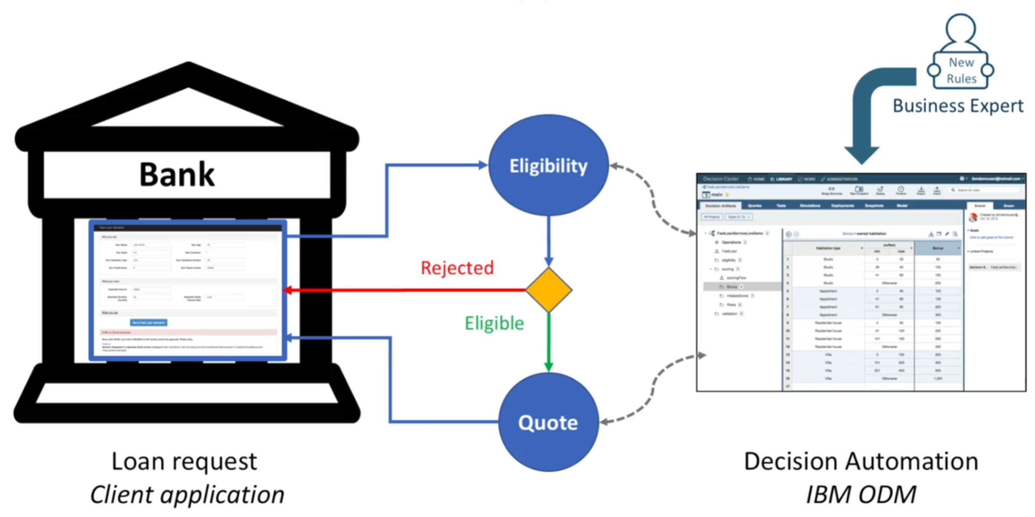
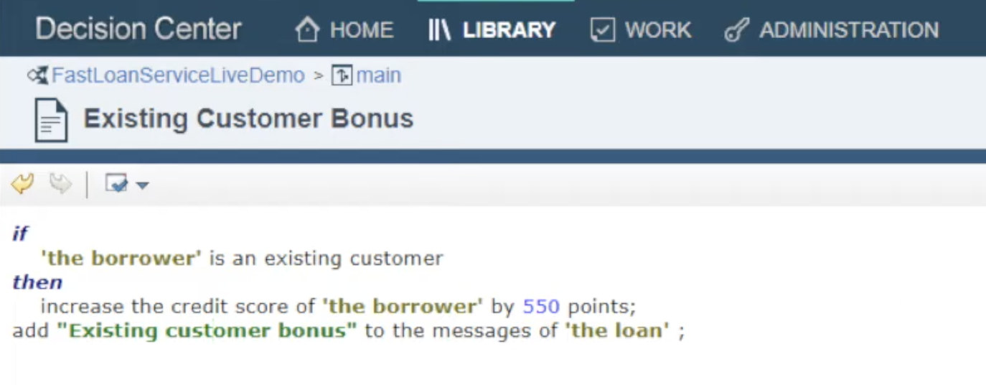
Context
A scenario of Application powered by ODM : online loan application

Slide 6
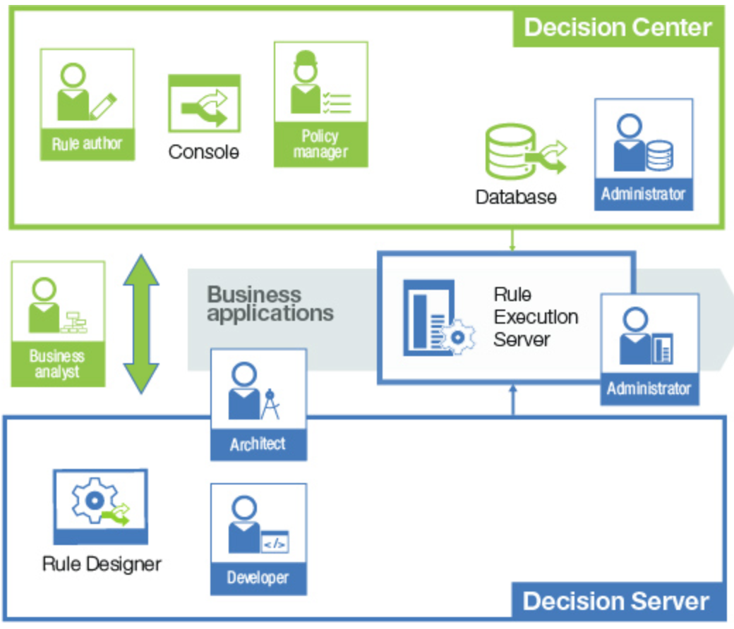
Context
Components of ODM
Decision Center
- business department to build the business rules
Decision Server
- developers to program to automate the response of decisions
Rule Execution Server
- runtime environment for running and monitoring decision services

Slide 7
Context
Sub-teams of ODM
RES
responsible for Rule Execution Server module of ODM
DC
responsible for Decision Center module
QA
responsible for the product building and Quality Assurance

Slide 8
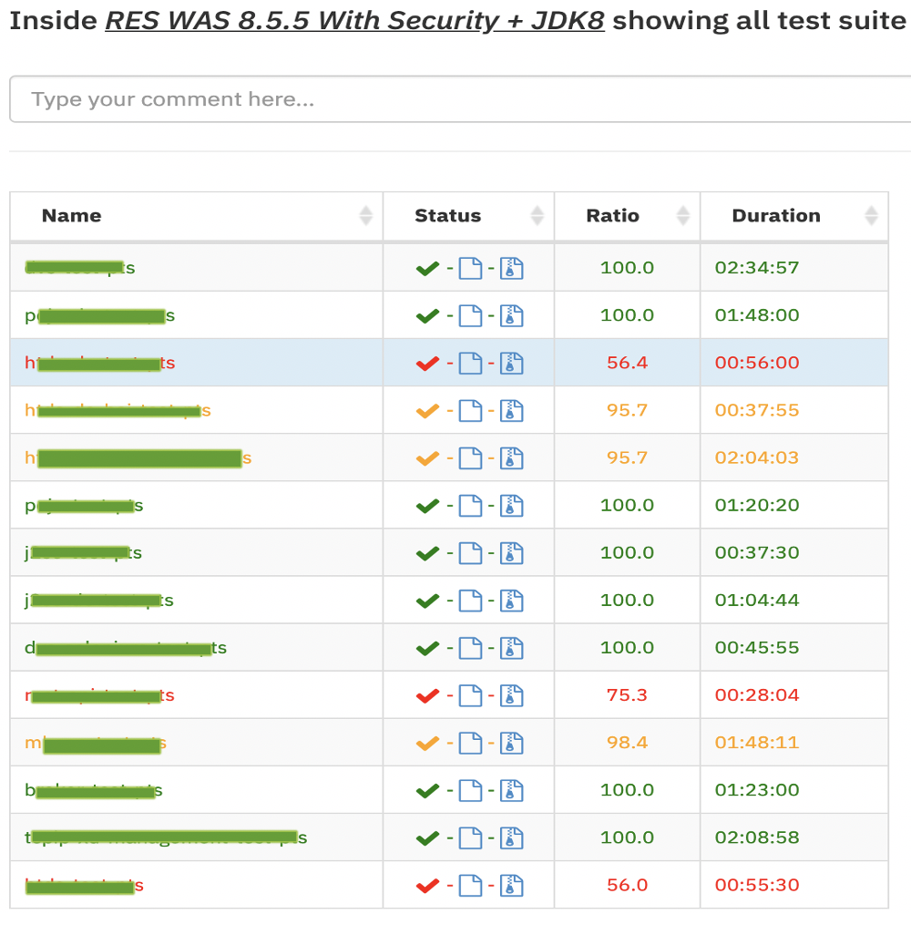
Context
About Versatile Testing Tool (VTT)
VTT is a testing and reporting system that can help developers to
execute the testing automation
visualize the test results with a web dashboard application.
The testing automation is executed on the remote machine.

Slide 9
Content
Problems :
How to analyze easily the reason why tests failed on remote machine caused by the difference of OS (Linux vs macOS)
How to easily test our code in different environments
Internship content :
First content :
Set up the computer
Get familiar with the product, development tools, environments
Implement some unit testing using Selenium
Second content :
Solve problems
Simplify the usage
Write documentations
Third content :
Improve the solutions
Improve the documentations

Slide 10
First Content :
Get familiar with everything + write automated tests
From March to April
Become familiar with
the product ODM
the development method
the structure of ODM
Implement automated tests with selenium.
Conclusion :
Finish building a foundation for my futures projects
Get to learn some communication skills though the weekly meeting
Succeed implementing several series of testing automation with Selenium.

Slide 11
Second Content :
Solve problems + complete documentations
Two Solutions :
Idea : fetch a release environment
Solution 1°: Work on the remote machine (remote control or secure shell)
Solution 2°: Simulate the release environment on local machine (Docker or VM)

Slide 12
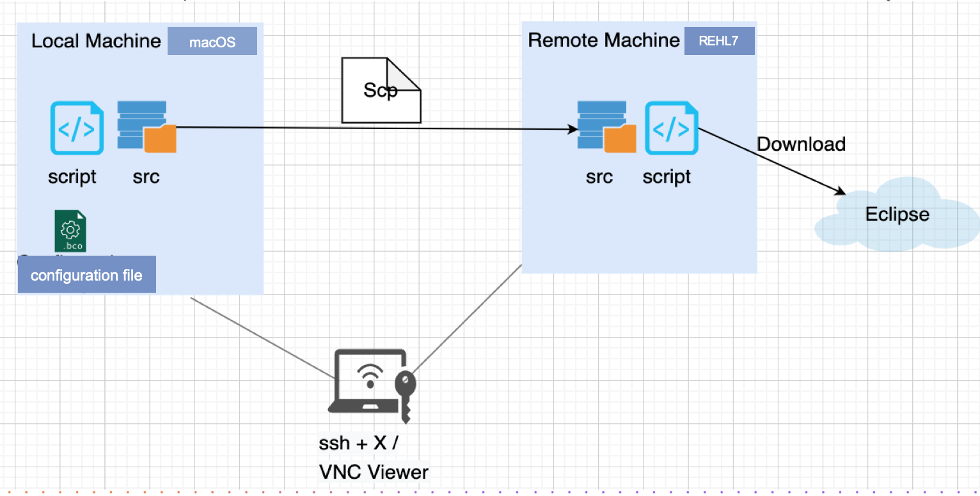
Second Content :
Solve problems + complete documentations
Solution 1°: Work on the remote machine -> Write shell scripts to configure remote machines

Slide 13
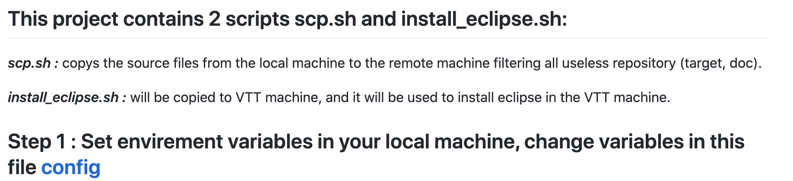
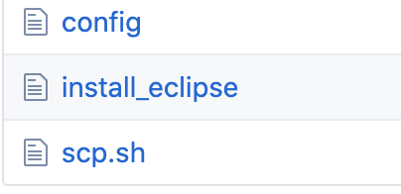
Second Content :
Solve problems + complete documentations
Solution 1°: Work on the remote machine -> Write shell scripts to configure remote machines
This solution contains three files:
config (property file)
Install_eclipse (shell script)
Scp.sh (shell script)
The screenshot of this project on GitHub

Slide 14
Second Content :
Solve problems + complete documentations
Solution 1°: Work on the remote machine -> Write shell scripts to configure remote machines
Advantages : We move the debugging process from the local machine to the remote machine. The development environment is exactly the same as the VTT release environment.
Disadvantages : High bandwidth is required. Remote machines are limited resources. But we wish to continue our work even when we don’t have a remote machine!

Slide 15
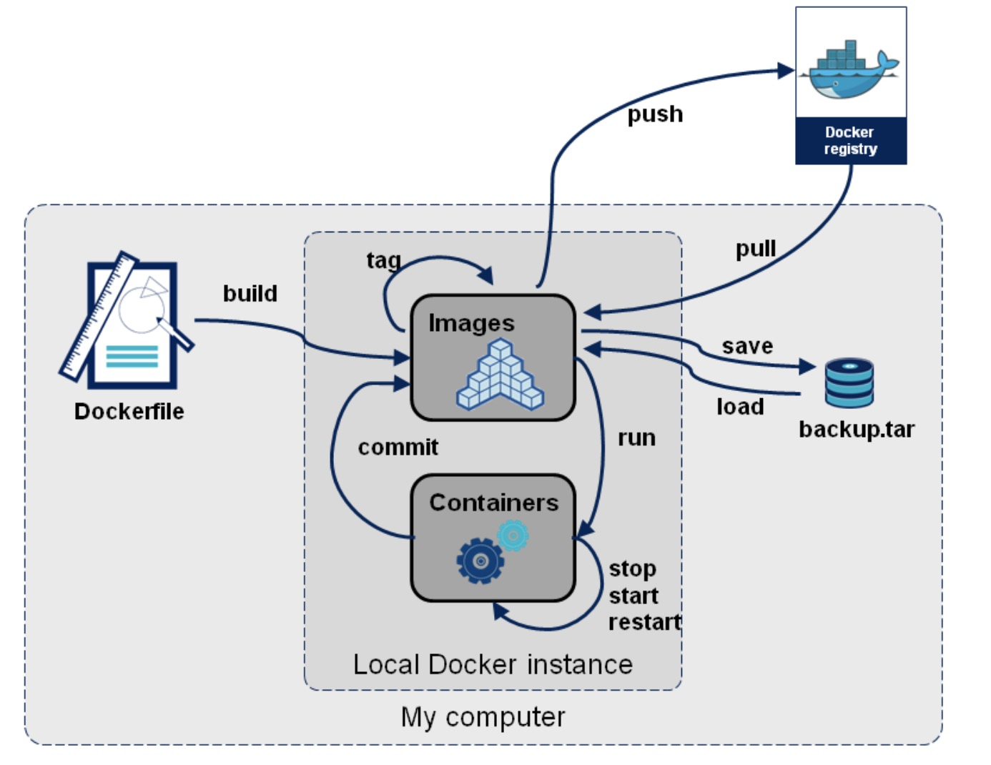
Second Content :
Solve problems + complete documentations
Solution 2°: Simulate the release environment on local machine
Strategy 2
Docker project
1
Pull the RedHat image from Docker registry
Docker file
2
Install necessary development tools
Configure the system environments in Docker
3
Build the Docker image, share source files with host
4
Launch
Execute a Docker container using the Docker image
5

Slide 16
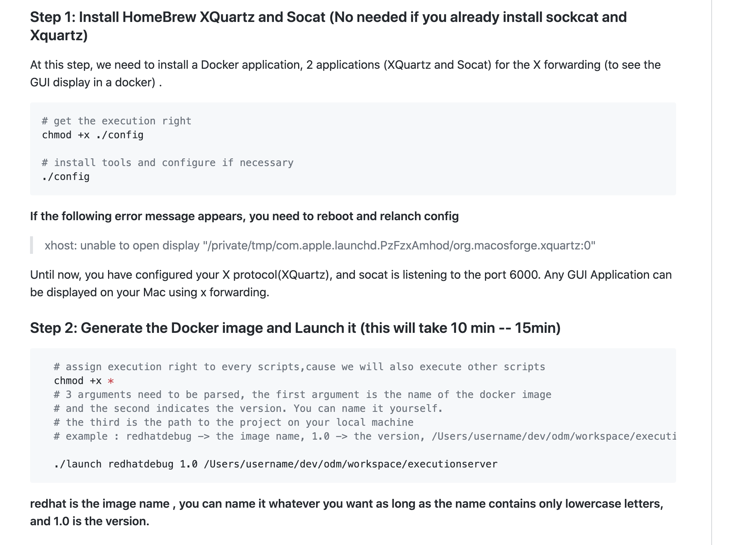
Second Content :
Solve problems + complete documentations
Solution 2°: Simulate the release environment on local machine
Strategy 2
The screenshot of this project in GitHub

Slide 17
Second Content :
Solve problems + complete documentations
Solution 2°: Simulate the release environment on local machine
Strategy 2
We get A virtual environment on the local machine that is almost the same as the release environment
Advantages :
No longer depend on the remote machine.
Run specific tests easily
Convenient modifications
Disadvantages : we can’t execute multiple tests in parallel on the same server

Slide 18
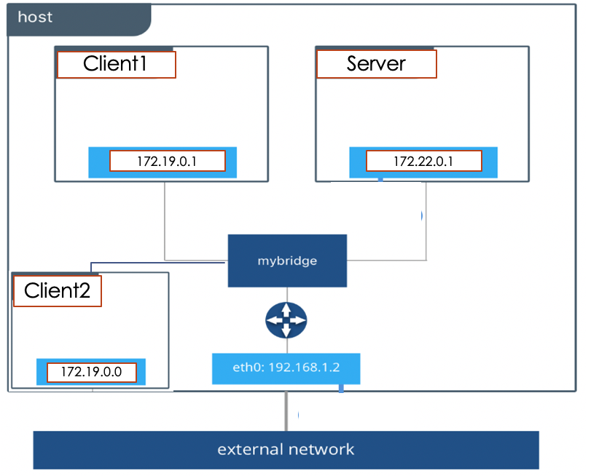
Third Content :
Improve solutions and documentations
Architecture of the improvements
Strategy 2
Advantages :
Through this project, we can directly build a virtual environment on the local machine that is almost the same as the release environment. It is quite simple to use and we don’t need a remote machine.

Slide 19
Internship Contribution
About 40 automated tests implemented during the first stage
Scripts to simplify the process of transferring source files and configuring the remote machine, which Improve the speed of setting up the remote compute from 20 min to less than 5 min.
Scripts to build docker images to simulate the release environment on local machine. No longer need to depend on the remote machine : launch specific testing easily with specific environments.

Slide 20
Conclusion
Programming in Java, developing testing automation with Selenium and scripting with shell. Deployment of a web project with several web servers on the Linux server, and the technics of virtualization.
Software development process, the Agile method which makes flexible responses to change, the real teamwork, communication skills like how to talk concisely and confidently.

Slide 21
Thanks
BY Jiarong LING
18/09/2020

